Slide 1
Marketing Birth Control Products in a Post-Dobbs World
A project to help Pfizer learn from the online conversation about birth control methods
Aaron Galbraith • 2023

Slide 2
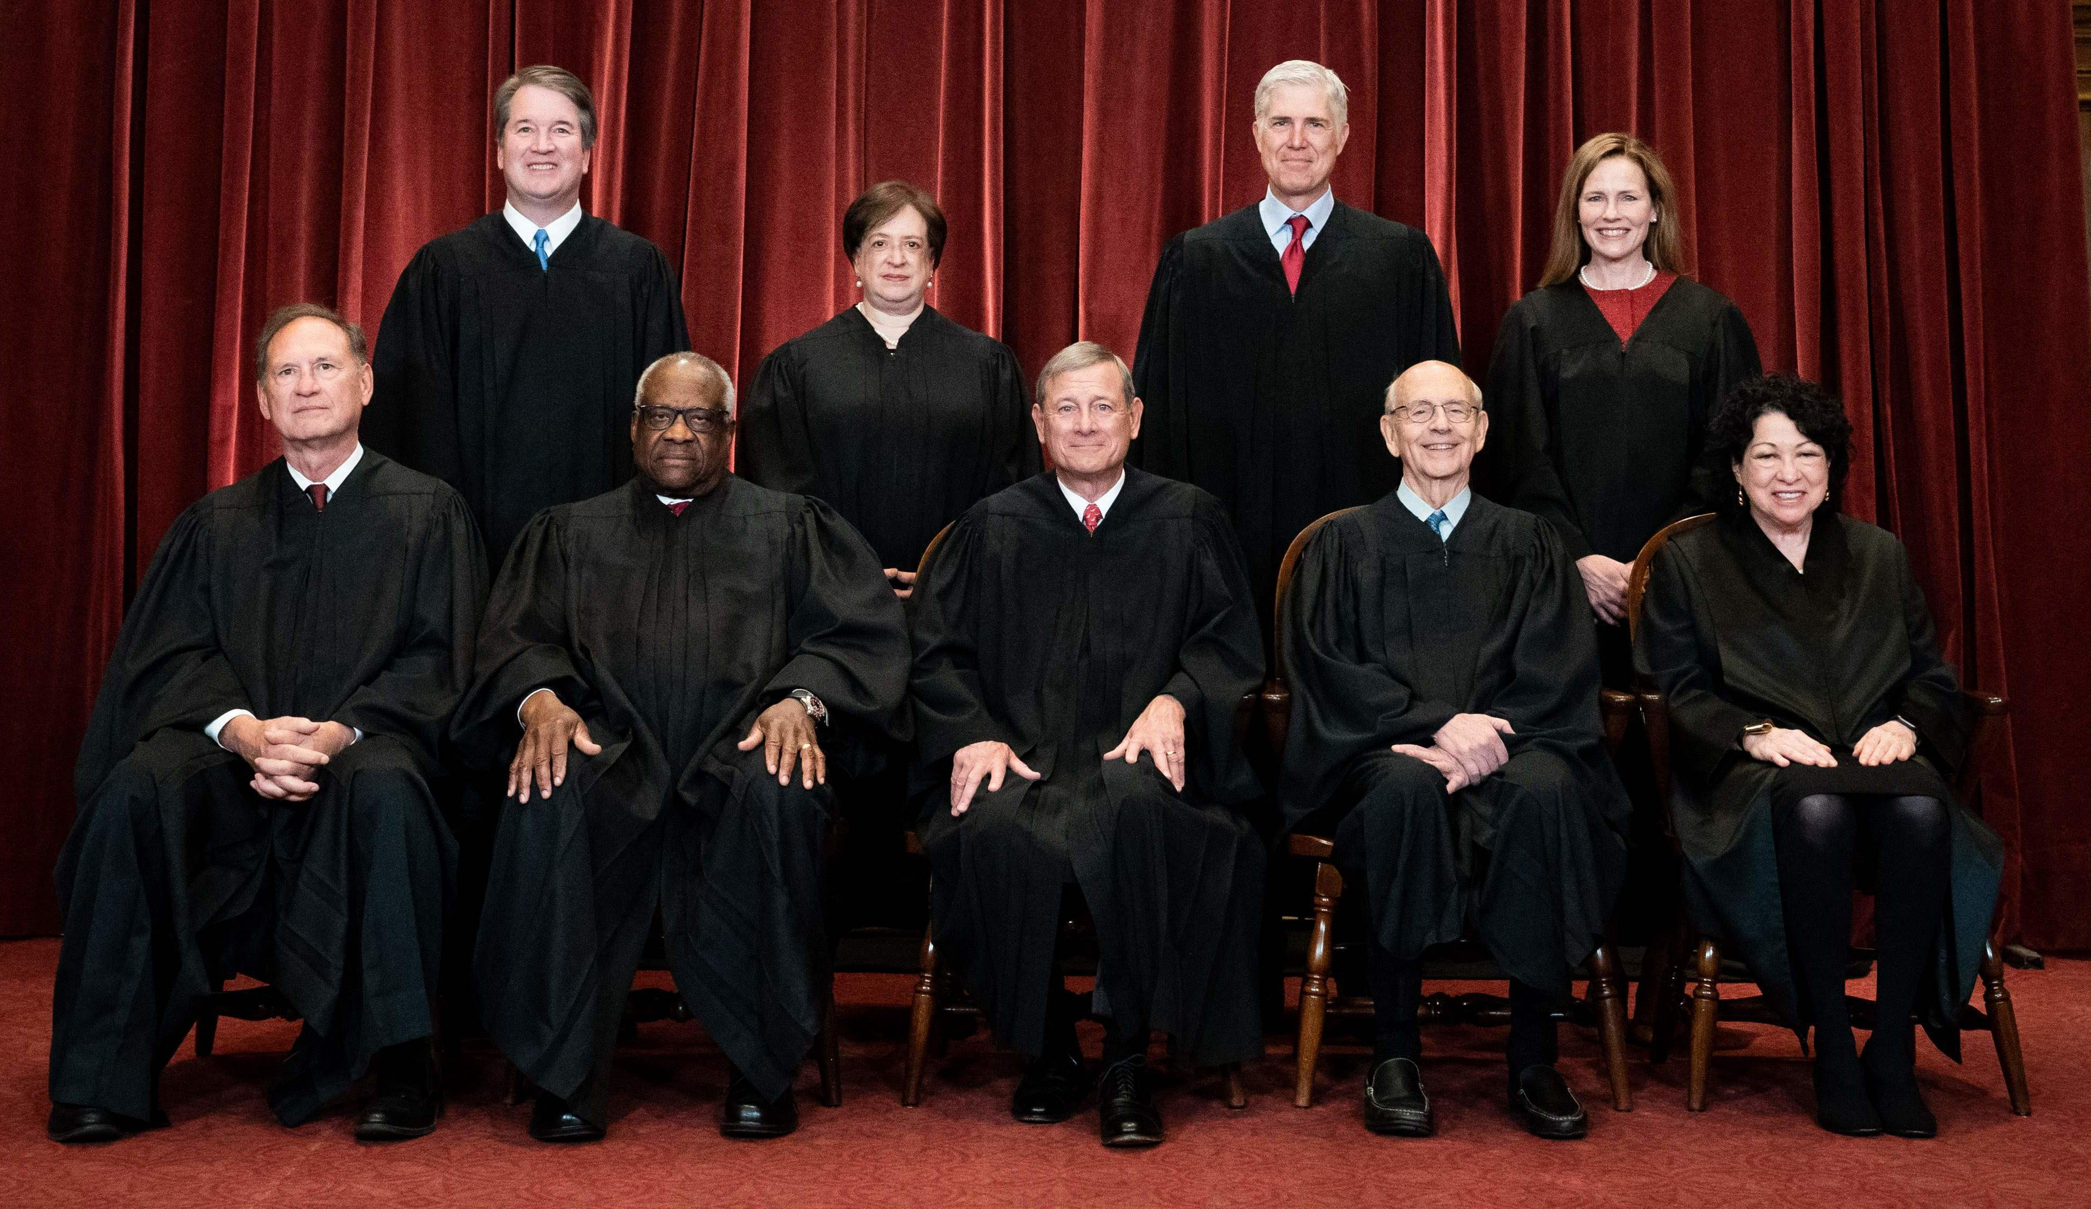


Background
2022 Dobbs ruling
reproductive health conversations
Pfizer

Slide 3
Project Goal
to help Pfizer understand public sentiment toward various birth control methods in order to develop and market their products accordingly

Slide 4
Data
20,000 reviews from 2008-2017
acquired from drugs.com by researchers at UC Irvine
1-10 rating
7 different birth control methods

Slide 5
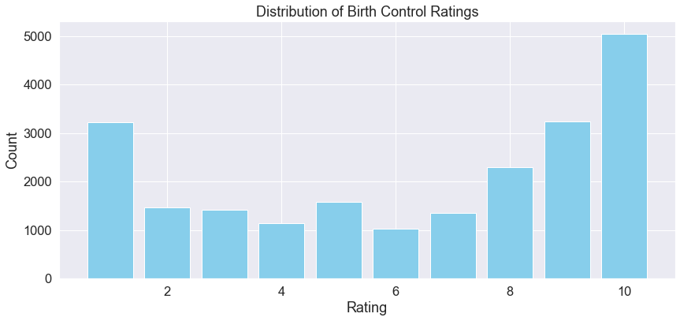
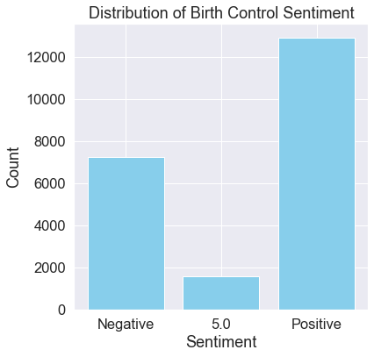

Slide 6
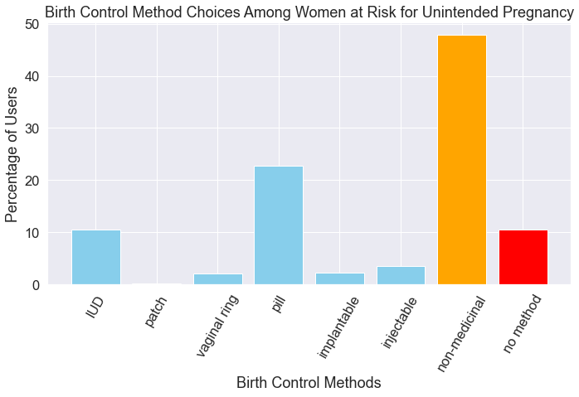
this data from the Guttmacher Institute, 2014

Slide 7
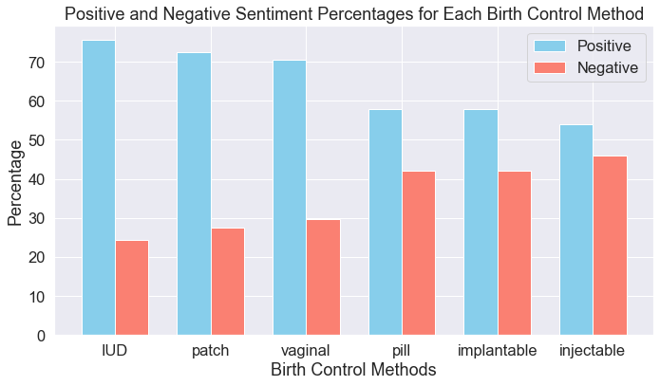

Slide 8
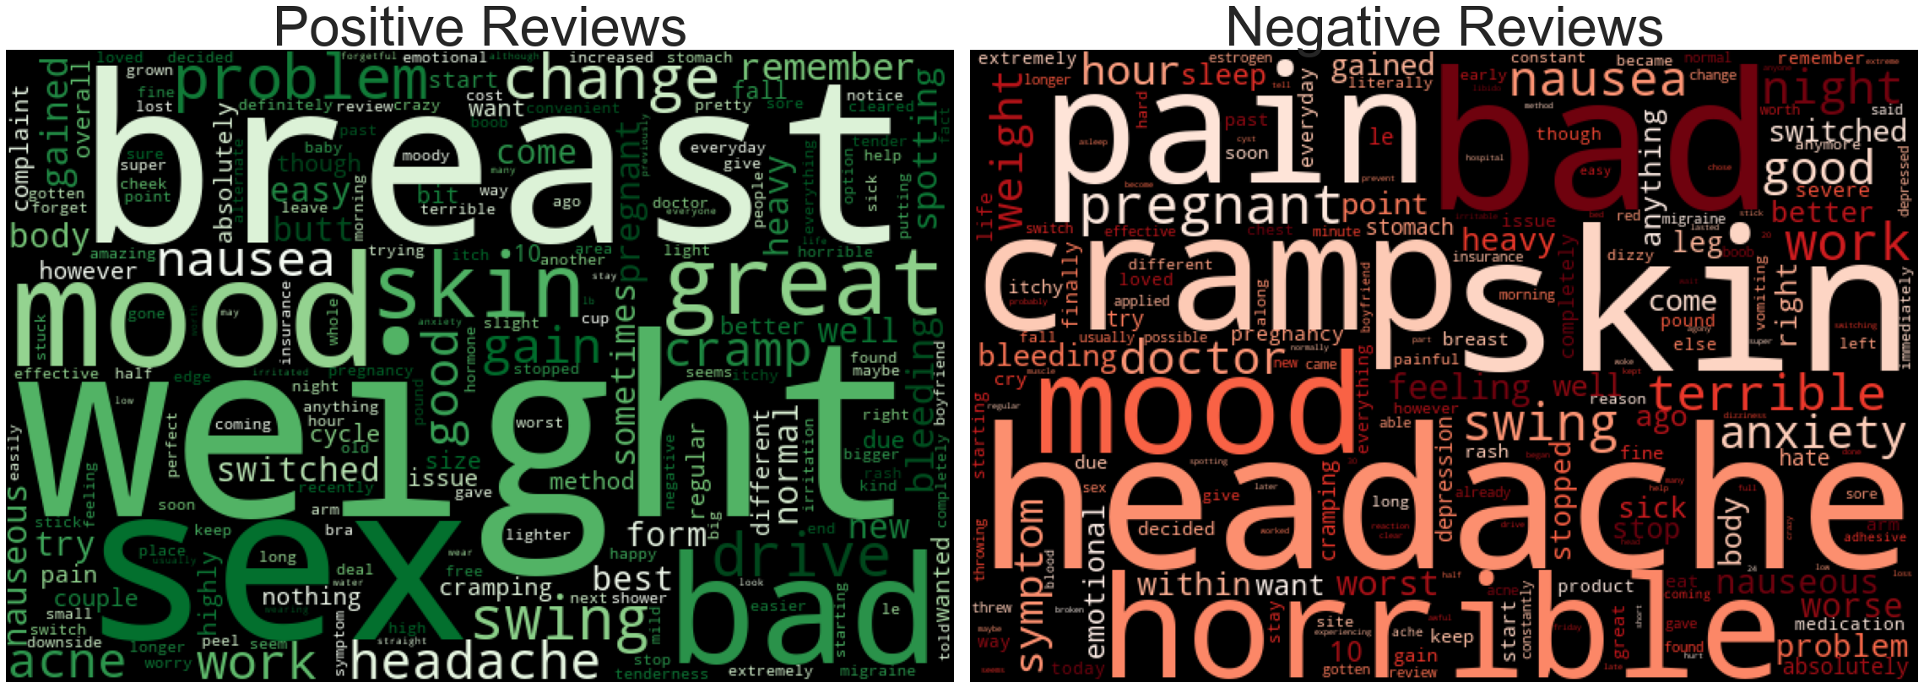
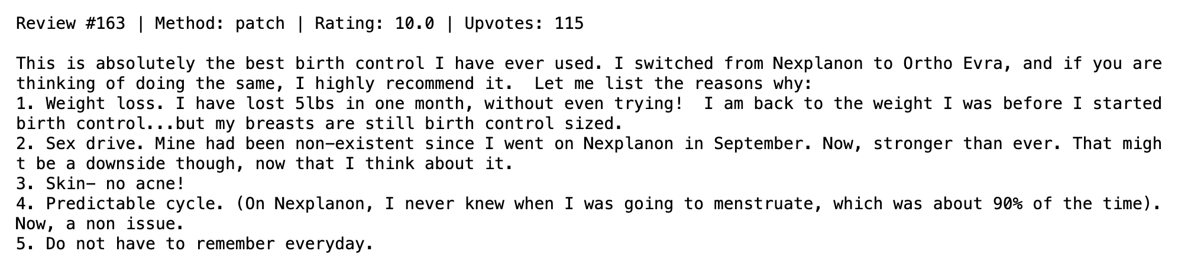
word clouds for patch reviews

Slide 9
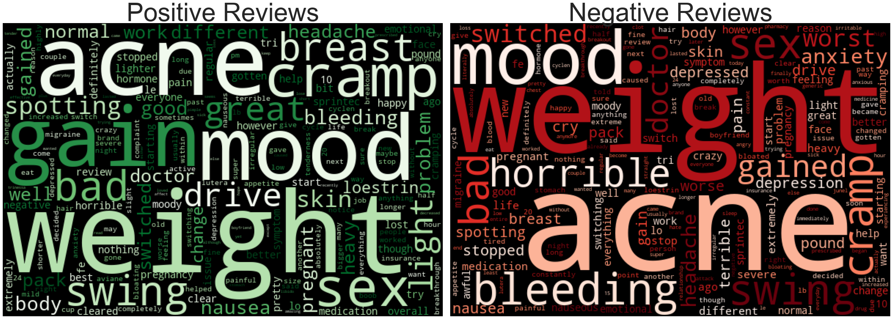
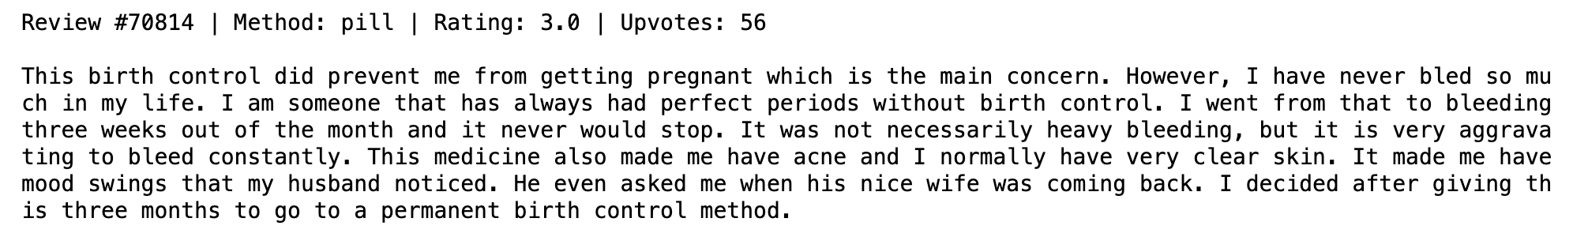
word clouds for pill reviews

Slide 10
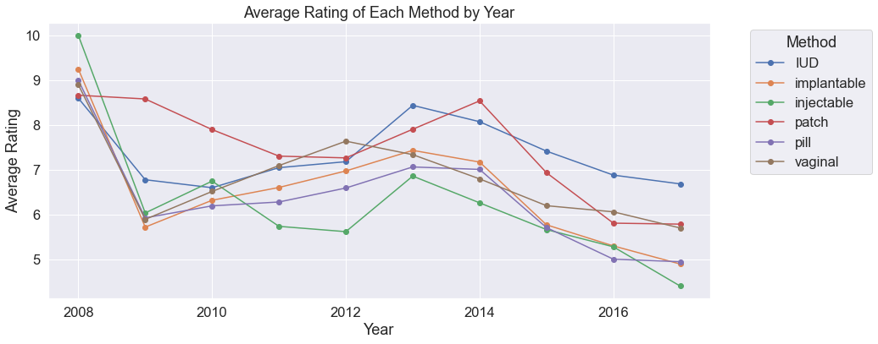

Slide 11
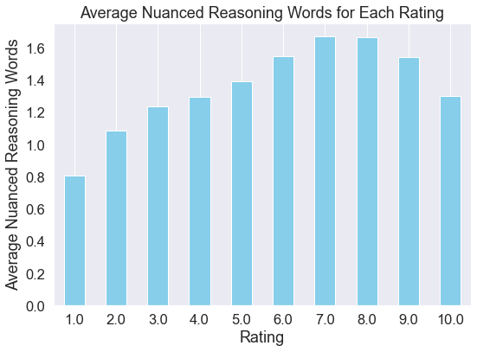

Slide 12
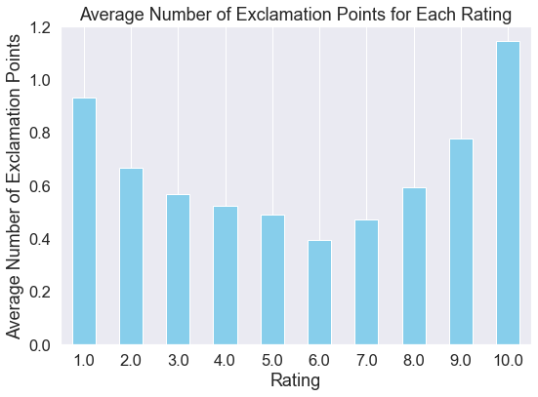

Slide 13
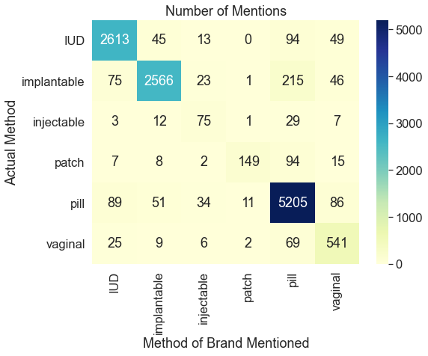

Slide 14
Methods
ChatGPT3 helped with brand categorization
ML classifiers: Naïve Bayes, Random Forest, Gradient Boost*
* final model
metric: accuracy

Slide 15

Results – predicting METHODS
model | F1-macro | accuracy
Decision Tree (BASELINE) | 0.82 | 87.2%
… with hyperparameter tuning | 0.84 | 88.3%
Random Forest | 0.59 | 83.3%
… with hyperparameter tuning | 0.59 | 83.3%
Logistic Regression | 0.87 | 92.1%
… with hyperparameter tuning | 0.90 | 94.2%

Slide 16
Results – predicting RATINGS
model | ROC-AUC | recall | accuracy
Decision Tree (BASELINE) | 0.69 | 55.2% | 72.6%
… with hyperparameter tuning | 0.75 | 80.5% | 70.8%
Random Forest | 0.92 | 61.3% | 82.4%
… with hyperparameter tuning | 0.93 | 63.0% | 83.1%
Logistic Regression | 0.93 | 96.0% | 77.2%
… with hyperparameter tuning | 0.95 | 91.3% | 86.3%

Slide 17
Recommendations
pop-up store + event synergy = great idea
throw a party
address battery life and design issues

Slide 18
Further Inquiry
analyze all three sentiments
incorporate more features to the model (e.g. tweet length)
get to the bottom of overfitting issues

Slide 19
Thank you
Aaron Galbraith • 2023
www.linkedin.com/in/aarongalbraith

